Slide 1
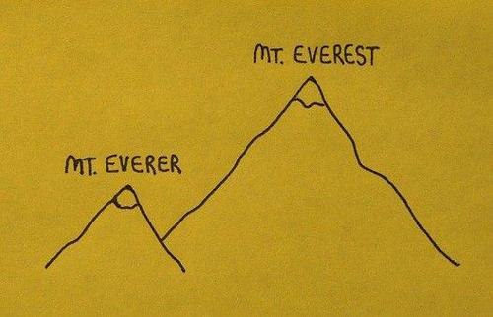

Slide 2
Comparatives & Superlatives
Syllabus p161

Slide 3
???
bv. ‘groot’
comparatief = ‘groter’
superlatief = ‘grootst’

Slide 4
One-syllable adjectives (p161)
+ -er old ➔ older
+ -est old ➔ oldest
!!! Study the irregular forms p161

Slide 5
Two-syllable adjectives p162
busy busier busiest
clever cleverer cleverest
careful more careful most careful

Slide 6

Longer adjectives (3 or more syllables)
expensive more expensive most expensive

Slide 7
Smarter than me Smarter than I am

Slide 8

The longer I wait, the more difficult it will be.
Hoe langer ik wacht,
hoe moeilijker het zal zijn.

Slide 9
Vergelijking van 2 dingen/personen
The bigger of the two
The biggest of the two

Slide 10

Exercises 1-4 p164-165

Slide 11

ACE
11 additional exercises

